Slide 1
Chapter 6: Interrupts, Resets, and Configuration
The PIC18 Microcontroller
Han-Way Huang
Minnesota State University, Mankato
June 2004

Slide 2
Interrupts
Without interrupts, the processor will execute programs by following the program logic flow.
Interrupt is an event that will cause the CPU to stop the normal program execution and provide some service to the event.
An interrupt can be generated inside and outside the microcontroller chip.
An external interrupt is generated when the external hardware asserts an interrupt signal to the CPU.
An internal interrupt can be generated by the hardware circuitry inside the chip and caused by software errors.
Abnormal situations that occur during program execution, such as illegal opcodes, overflows, divide-by-zero, and underflow, are referred to as software interrupts.
Software interrupts are also called traps and exceptions.
A good analogy for interrupt is how one will act when there is a incoming phone call.

Slide 3
Applications of Interrupts
Coordinate I/O activities and prevent CPU from being tied up during the data transfer process.
Perform time-critical operation—one example is process control.
Provide a graceful way to exit from the application when a software error occurred.
Remind the CPU to perform routine tasks:
1. Keep track of time of day
2. Periodic data acquisition
3. Task switching in a multi-tasking operating system
4. Others

Slide 4
Interrupt Maskability
Some interrupts are not desirable under some situations and should be ignored by the CPU. These interrupts are called maskable interrupt.
- Other interrupts represent events that the CPU shouldn’t ignore and must take immediate action. These interrupts are called nonmaskable interrupts.
- A program can disable (mask) an interrupt by setting or clearing a bit for most
processors.
- An interrupt is pending when it is active but not serviced by the CPU

Slide 5
Interrupt Priority
A microcontroller or microprocessor normally have multiple interrupt sources.
More than one interrupt source can be pending at the same time.
The CPU needs to decide which one of the pending interrupts to service.
The solution for handling multiple pending interrupts is to prioritize all interrupts.
The interrupt at the higher priority will be attended before the interrupt at the lower priority.
Interrupt priority can be implemented by the hardware or software.
The PIC18 supports two-level interrupt priority only and let the software to decide which pending interrupt to service.

Slide 6
Interrupt service
The CPU provides service to an interrupt by executing an interrupt service routine.
After providing service to the pending interrupt, the CPU must resume normal program execution.
The complete interrupt service cycle involves the following:
1. Saving the program counter in the stack
2. Saving the CPU status in the stack (optional for some processor)
3. Identifying the interrupt source
4. Resolving the starting address of the corresponding interrupt service routine
5. Executing the interrupt service routine
6. Restoring the CPU status from the stack
7. Restoring the program counter from the stack
8. Resuming the interrupted program
For maskable interrupts, the CPU starts to provide service to the interrupt after it completes the execution of the current instruction.
For some maskable interrupts, the CPU may provide service to the interrupt without completing the current instruction.

Slide 7
Interrupt Vector
The starting address of the interrupt service routine is called interrupt vector.
There are three methods for determining the interrupt vector:
1. Predefined.
2. Stored in a predefined memory location
3. Execute an interrupt vector acknowledge cycle to fetch a vector number to locate the interrupt vector.
The PIC18 uses the first method to identify the interrupt vector.

Slide 8
Interrupt Programming
Step 1. Write the service routine
org ox08
… ; interrupt service for high priority interrupts
retfie
org 0x18
… ; interrupt service for low priority interrupts
retfie
Step 2. Initialize the interrupt vector table
(not needed for PIC18)
Step 3. Enable interrupts to be serviced

Slide 9
The PIC18 Interrupt Sources
Four edge-triggered INT pin (INT0…INT3) interrupts
Port B pins change (any one of the upper four Port B pins)
On-chip peripheral function interrupts. Not all the PIC18 members have the same number of peripheral function interrupts.
Registers Related to Interrupts
These registers enable/disable the interrupts, set the priority of the interrupts, and record the status of each interrupt source.
- RCON
INTCON
INTCON2
INTCON3
PIR1, PIR2, and PIR3
PIE1, PIE2, and PIE3
IPR1, IPR2, and IPR3
Each interrupt source has three bits to control its operation:
A flag bit
An enable bit
A priority bit

Slide 10
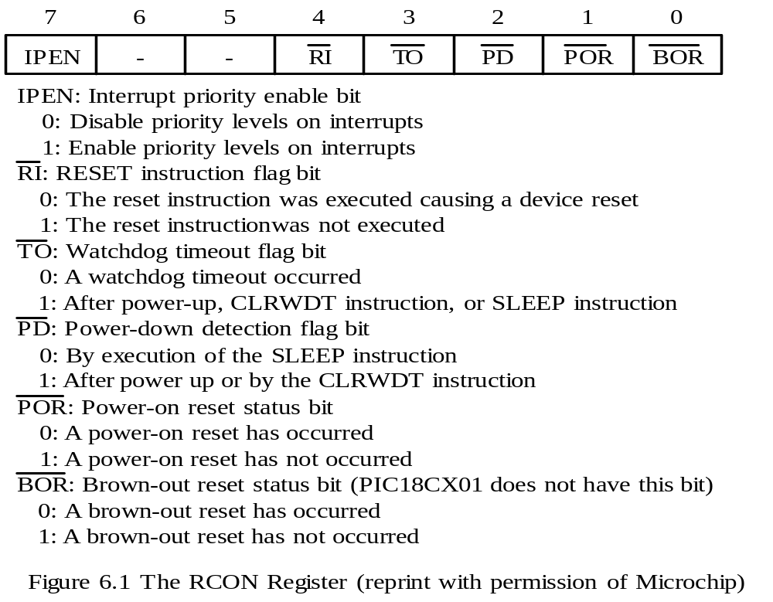
RCON register

Slide 11
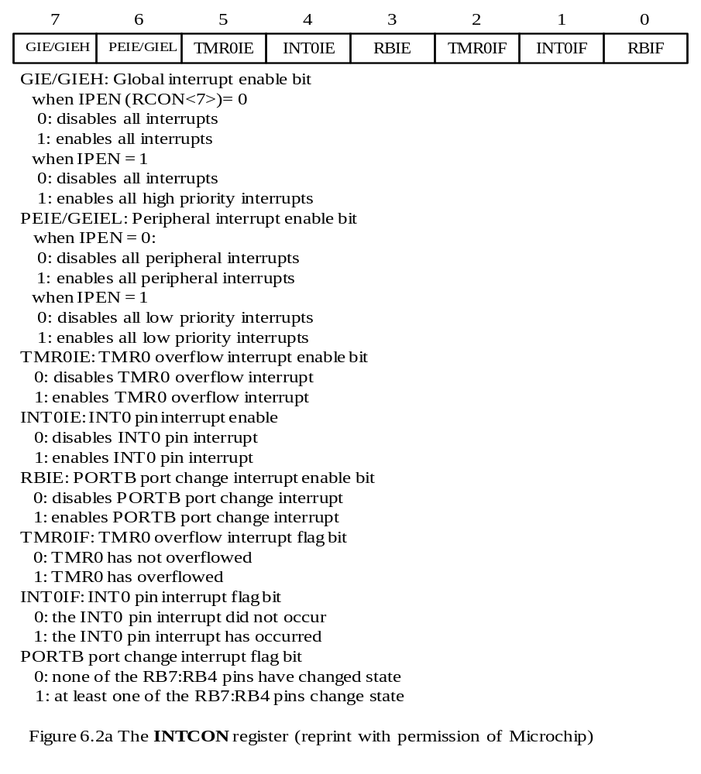

Slide 12
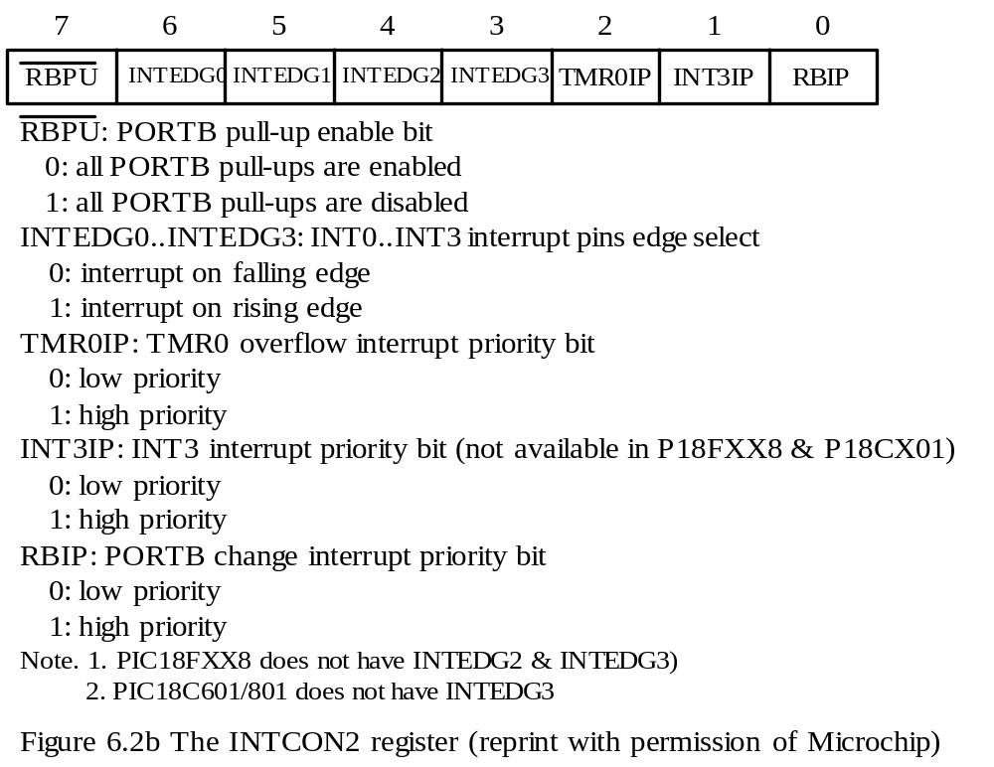

Slide 13
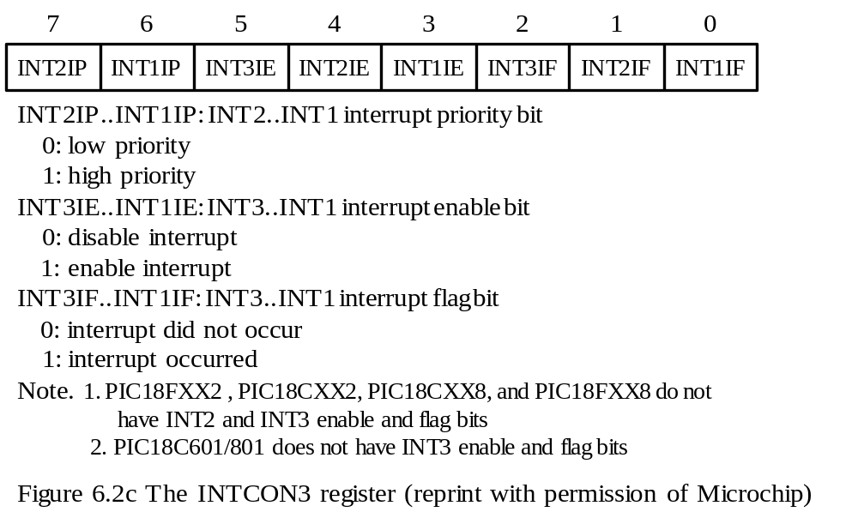

Slide 14
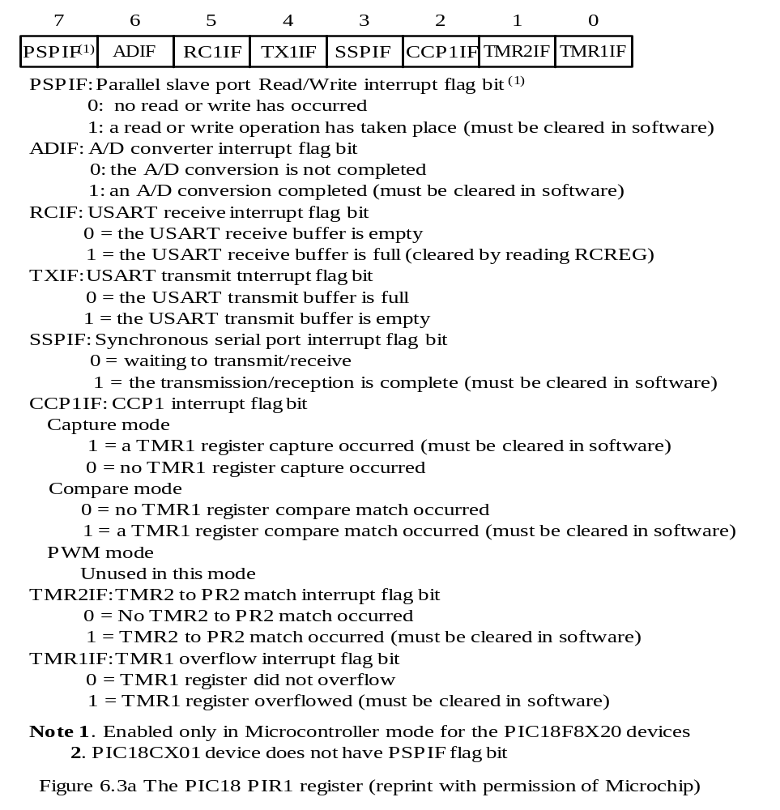

Slide 15
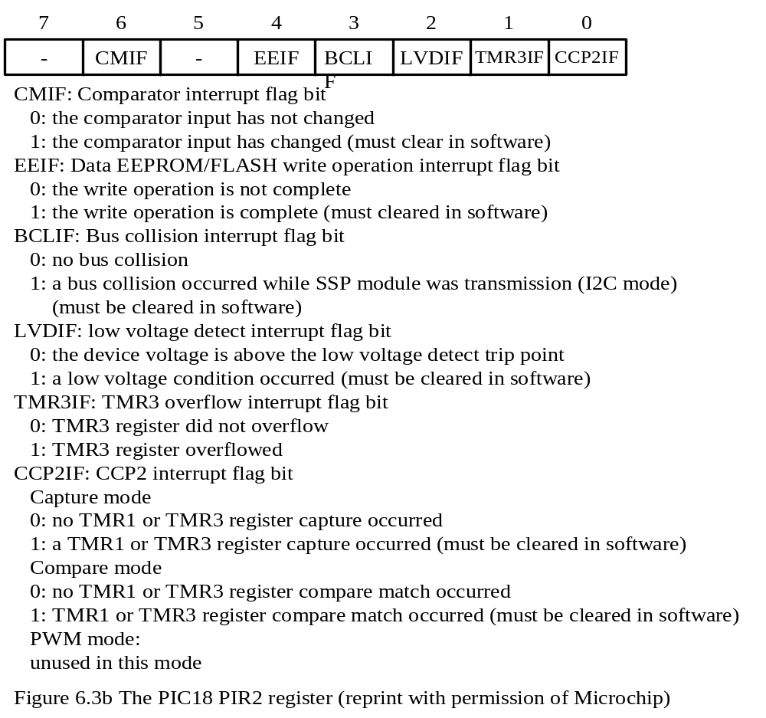

Slide 16
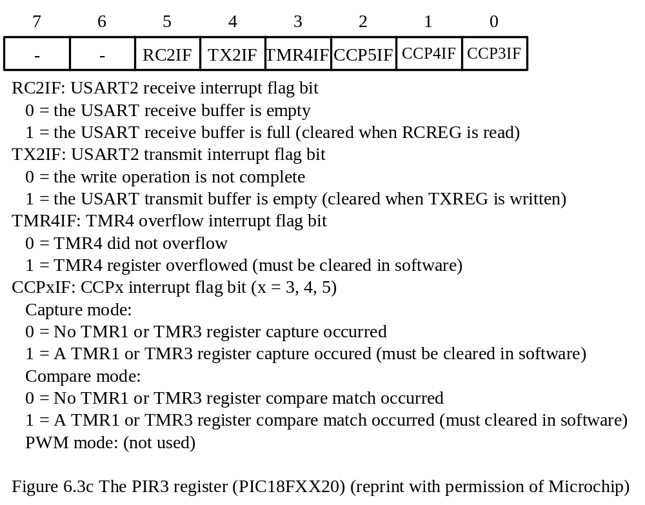

Slide 17
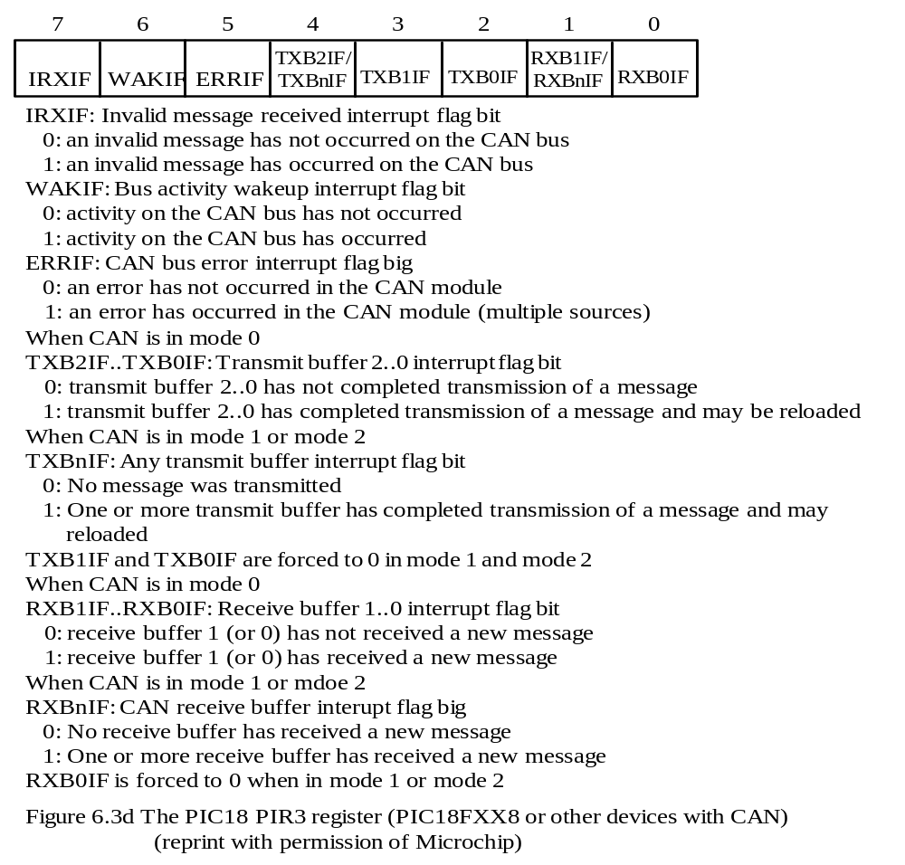

Slide 18
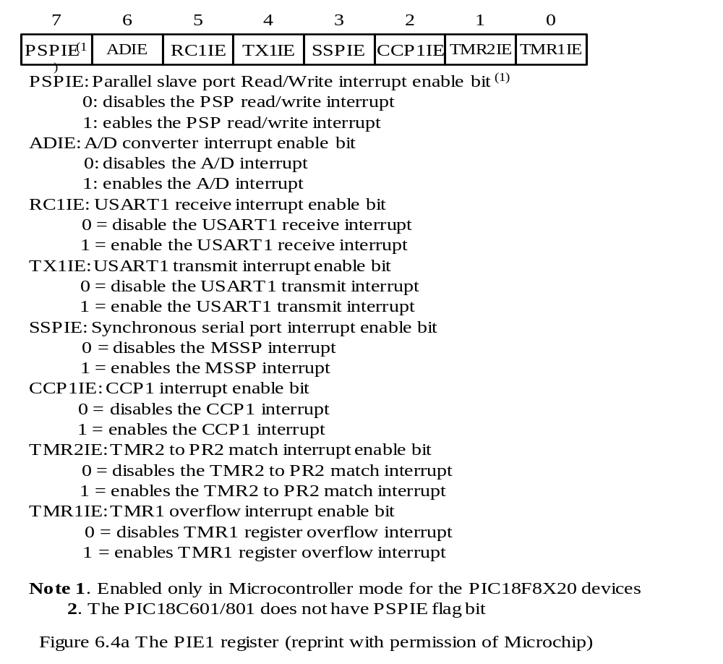

Slide 19
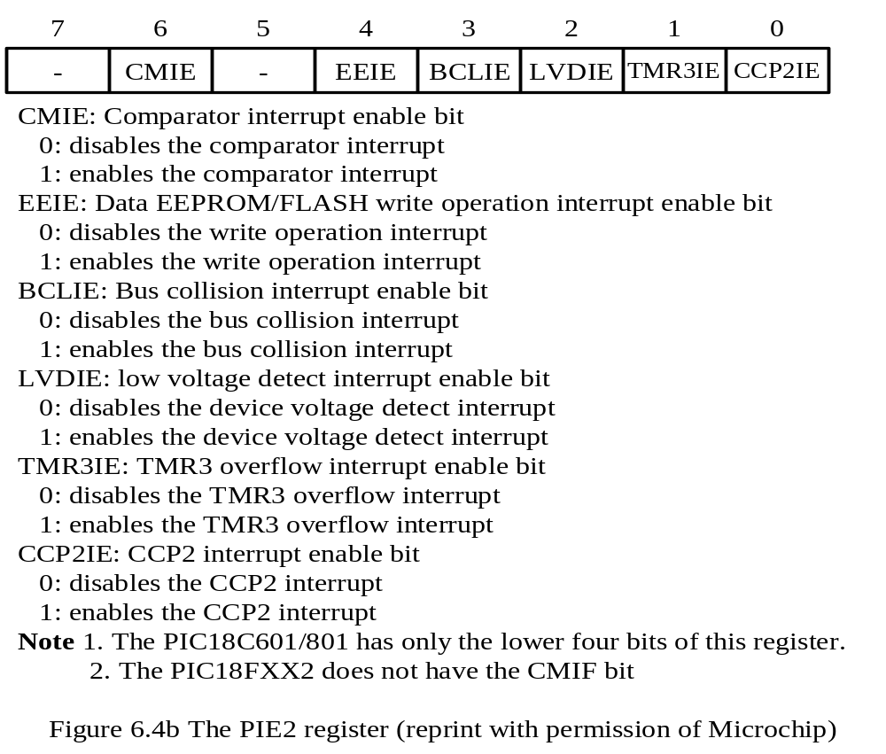

Slide 20
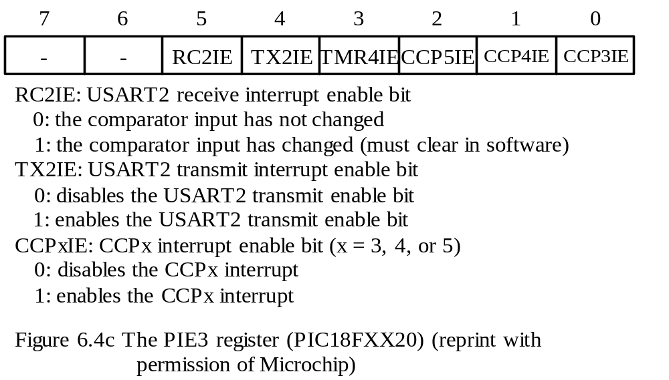

Slide 21
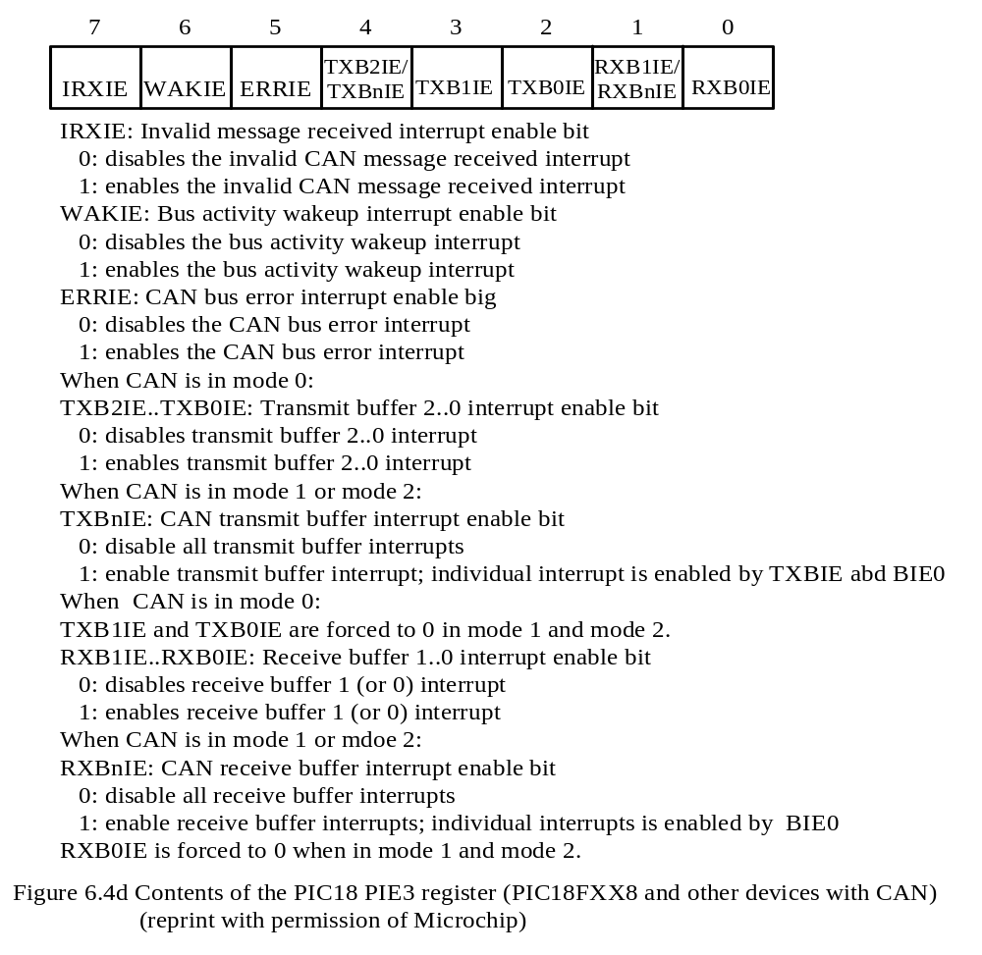

Slide 22
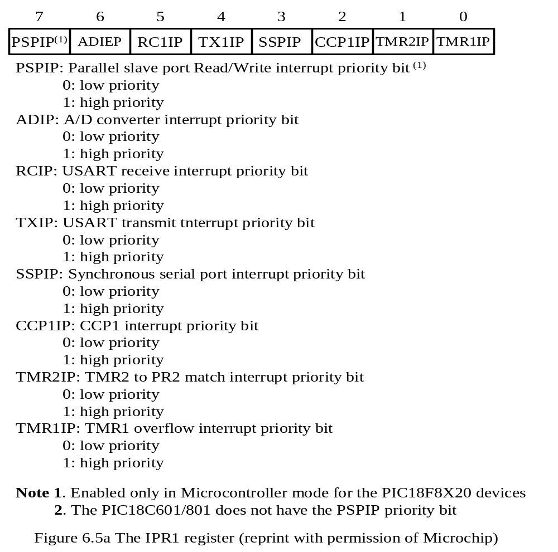

Slide 23
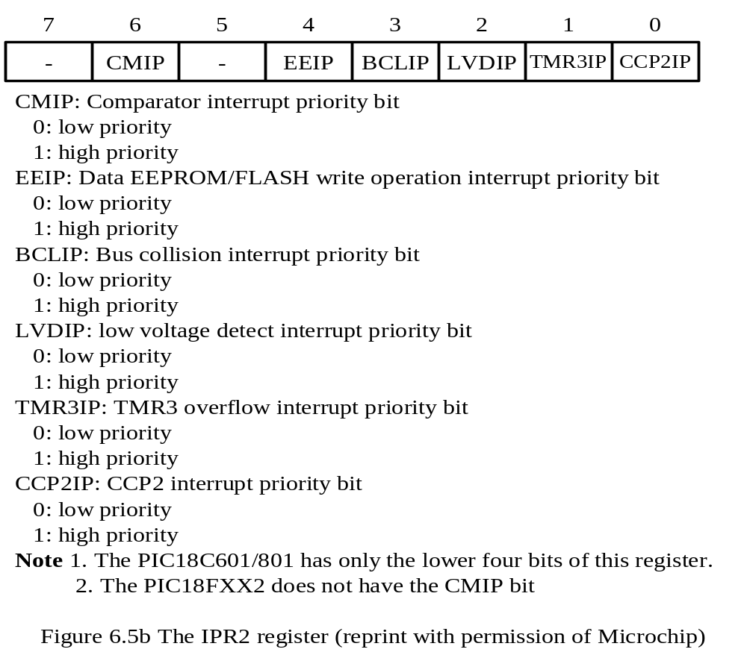

Slide 24
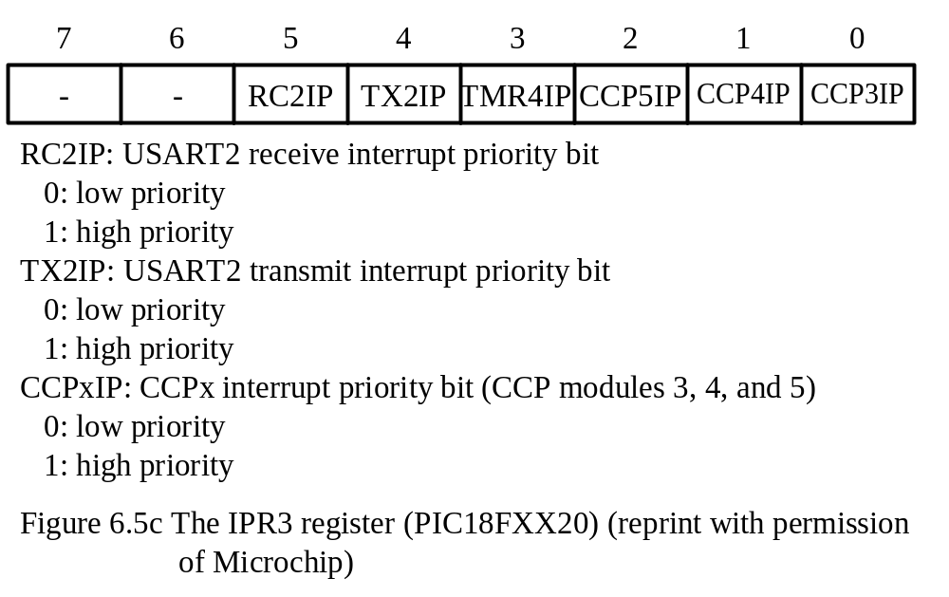

Slide 25
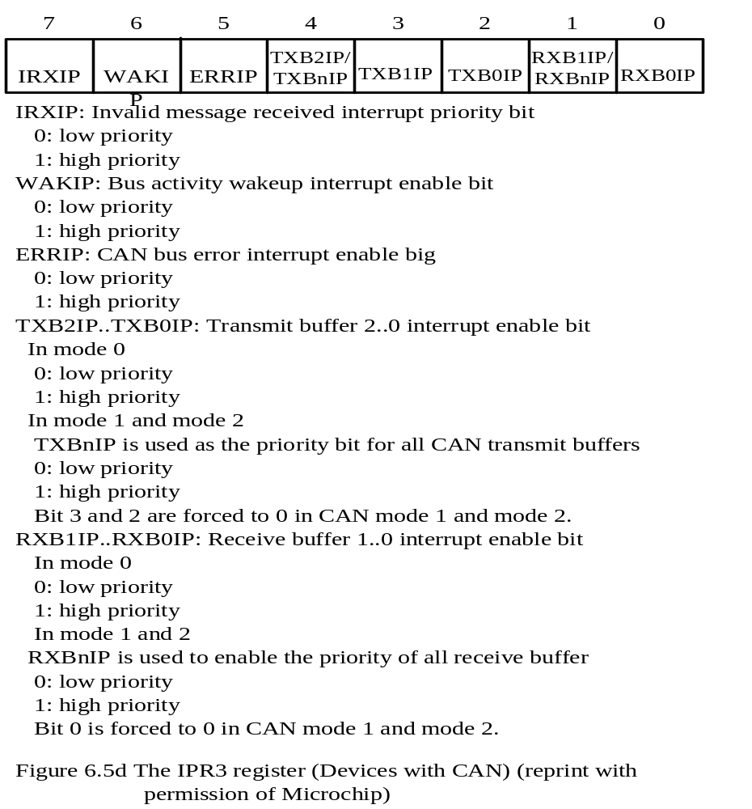

Slide 26
PIC18 Interrupt Operation
The interrupt priority scheme can be enabled or disabled.
All interrupts are divided into core group and peripheral group.
The priority bits of the interrupts sources in the core group are contained in one of the interrupt control registers.
When the priority scheme is enabled, all high-priority interrupts are under the control of a two-level interrupt enabling mechanism.
All low-priority interrupts are under the control of a three-level interrupt enabling scheme.
When the priority scheme is disabled, all interrupts in the core group are under the control of a two-level interrupt enabling scheme.
All interrupts in the peripheral group are under the control of a three-level enabling scheme.
The following interrupts are in the core group:
1. INT0…INT3 pin interrupts
2. TMR0 overflow interrupt
3. PORTB input pin (RB7…RB4) change interrupts
When an interrupt is responded to, the GIE bit is cleared to disable further interrupt. the return address is pushed onto return address stack and the PC is loaded with the interrupt vector.

Slide 27
PIC18 Interrupts without Setting Priority
The priority scheme is disabled by clearing the bit 7 of the RCON register.
All interrupt sources share the common interrupt vector at 0x08.
In order to identify the cause of interrupt, one need to check each individual interrupt flag bit.
The interrupt sources in the core group can be enabled by setting the GIE bit and the corresponding enable bit of the interrupt source.
To enable TMR0 interrupt, for example, one must set both the GIE and the TMR0IE bits to 1.
The interrupts in the peripheral group can be enabled by setting the GIE, PEIE, and the associated interrupt enable bits.
To enable A/D interrupt, one needs to set the GIE, PEIE, and the ADIE bits

Slide 28
PIC18 Interrupts with Priority Enabled
Should be used when certain interrupts need to be serviced promptly.
The PEIE bit of the INTCON register is used as the low-priority interrupt enable bit.
A high-priority interrupt is enabled when the GIEH bit and its interrupt enable bit are set to 1.
A low-priority interrupt is enabled when the GIEH, GIEL, and its associated interrupt enable bits are all set to 1.
By default, all interrupts are placed in high priority.
The pending interrupts in the high-priority group will always be served before the interrupts in the low-priority group.
Interrupt flags must be cleared in the interrupt service routine to avoid recursive interrupts.

Slide 29
INT0…INT3 Pin Interrupts
All INT pins interrupt are edge-triggered.
The edge-select bits are contained in the INTCON2 register.
When an edge-select bit is set to 1, the corresponding INT pin interrupt on the rising edge.
Port B Pins Input Change Interrupt
An input change on pins RB7…RB4 sets the flag bit RBIF (INTCON<0>).
If the RBIE bit is set, then the setting of the RBIF bit causes an interrupt.
In order to use this interrupt, the RB7…RB4 pins must be configured for input.
TMR0 Overflow Interrupt
The Timer0 module contains a 16-bit timer TMR0.
Timer0 can operate in either 8-bit or 16-bit mode.
When TMR0 rolls over from 0xFF to 0x00 or from 0xFFFF to 0x0000, it may trigger an interrupt.

Slide 30
PIC18 Interrupt Programming
Two steps are needed:
Step 1
Write the interrupt service routine and place it in the predefined program memory.
Step 2
Set the appropriate interrupt enable bits to enable the desired interrupt.
A circuit for illustrating interrupt programming is shown in Figure 6.6b.
The circuit is available in SSE452, SSE8680, and SSE8720 demo boards.
Connect the 1 Hz output from the function generator to the INT0 pin.
By enabling the INT0 interrupt, the INT0 pin will generate an interrupt to the CPU once every second.
The interrupt service routine simply increments a memory counter, outputs it to the Port D pins, and returns.
An LED is turned on when its driving Port D pin outputs a low.
Example 6.1 Write an assembly program to handle the INT0 interrupt for the circuit shown in Figure 6.6b.

Slide 31
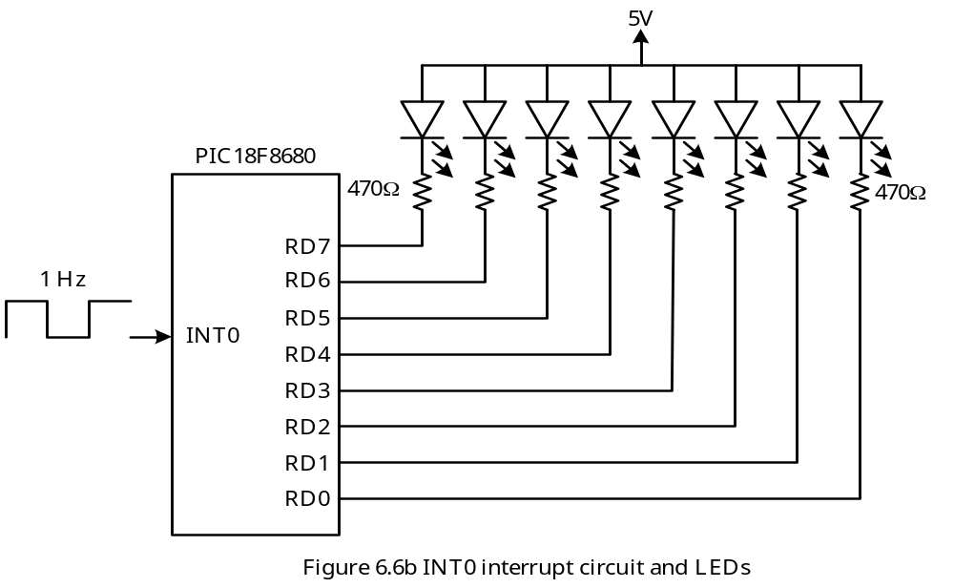

Slide 32
#include <p18F8680.inc>
count equ 0x00
org 0x00
goto start
org 0x08
goto ISR_hi
org 0x18
retfie
start setf count ; count down from 255
clrf TRISD ; configure port D for output
movff count,PORTD ; output count to LEDs
bsf RCON,IPEN ; enable priority interrupt
movlw 0x90 ; enable INT0 interrupt
movwf INTCON ; and clear INT0IF flag
forever nop
bra nop
ISR_hi btfss INTCON,INT0IF ; check interrupt source
retfie ; not caused by INT0, return
decf count,F
movff count,PORTD ; output count to LEDs
retfie

Slide 33
Interrupt Programming Template in C
#include <p18Fxxx.h>
void low_ISR(void);
void high_ISR(void);
#pragma code high_vector = 0x08 // force the following statement to start at
void high_interrupt (void) // 0x08
{
_asm
goto high_ISR;
_endasm
}
#pragma code //return to the default code section
#pragma interrupt high_ISR
void high_ISR (void)
{
… //handle high-priority interrupts
}

Slide 34
#pragma code low_vector = 0x18 //force the following statements to start at
void low_interrupt (void) //0x18
{
_asm
goto low_ISR;
_endasm
}
#pragma code //return to the default code section
#pragma interruptlow low_ISR
void low_ISR (void)
{
… //handle low-priority interrupts
}
void main (void)
{
…
}

Slide 35
Example 6.2 Write a C language version of the program for example 6.1.
#include <p18Fxxx.h>
void low_ISR(void);
void high_ISR(void);
unsigned char count;
#pragma code high_vector = 0x08 // force the following statement to start at
void high_interrupt (void) // 0x08
{
_asm
goto high_ISR;
_endasm
}
#pragma code //return to the default code section
#pragma interrupt high_ISR
void high_ISR (void)
{
if (INTCONbits.INT0IF){ //handle high-priority interrupts
count++;
PORTD = count;
}
}

Slide 36
#pragma code low_vector = 0x18 //force the following statements to start at
void low_interrupt (void) //0x18
{
_asm
goto low_ISR;
_endasm
}
#pragma code //return to the default code section
#pragma interruptlow low_ISR
void low_ISR (void)
{
_asm // handle low-priority interrupts
retfie // simply return
_endasm
}

Slide 37
void main (void)
{
TRISD = 0x00; // Configure PORTD for output
count = 0xFF; // turn off all LEDs initially
PORTD = count; // “
RCONbits.IPEN = 1; // enable priority interrupt
INTCON = 0x90; // enable INT0 interrupt
while (1); // stay in an infinite loop
}

Slide 38
Context Saving During Interrupts
When an interrupt occurs, the PIC18 MCU saves WREG, BSR, and STATUS in the fast register stack.
The user can use the retfie fast instruction to retrieve these registers before returning from the interrupt service routine.
One can save additional registers in the stack if the interrupt service needs to modify these registers. These registers must be restored before returning from the service routine.
In C language, one can add a save clause to the #pragma statement to inform the C compiler to generate appropriate instructions for saving additional registers.
#pragma interrupt high_ISR save = reg₁,…,reg_{n}
#pragma interrupt low_ISR save = reg1,…,regn
A whole section of data can be saved by the following statements:
#pragma interrupt high_ISR save = section(“section name”)
#pragma interrupt low_ISR save = section(“section name”)

Slide 39
Resets
Resets can establish the initial values for the CPU registers, flip-flops, and control registers of the interface chips so that the computer can function properly.
The reset service routine will be executed after the CPU leaves the reset state.
The reset service routine has a fixed starting address and is stored in the read only memory.
The PIC18 can differentiate the following types of reset:
1. Power-on reset (POR)
2. MCLR pin reset during normal operation
3. MCLR pin reset during sleep mode
4. Watchdog timer (WDT) reset (during normal operation)
5. Programmable brown-out reset (BOR)
6. RESET instruction
7. Stack full reset
8. Stack underflow reset

